Slide 1
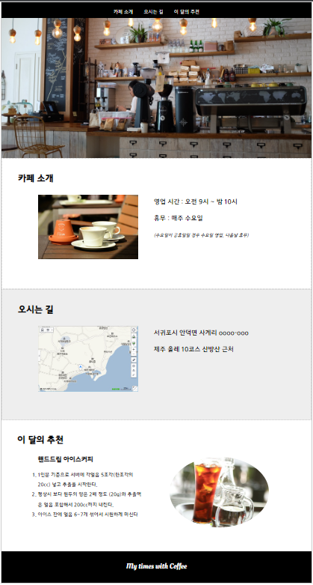
Header
Nav(list)
barner
h1

Slide 2


Slide 3


